Slide 1
Design Patterns

Slide 2
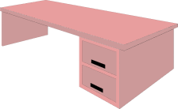

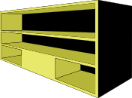
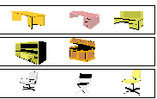
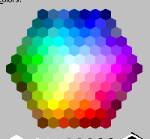
Prototype
Selection Problem
Furniture color
Click on choice of desk:
Furniture hardware type
Click on choice of storage:
Click on choice of chair:
colonial

Slide 3
Prototype
The Prototype pattern is used when creating an instance of a class is very time-consuming or complex in some way.
Then, rather than creating more instances, you make copies of the original instance, modifying them as appropriate.
Assume that a prototype instance is known; clone it whenever a new instance is needed.

Slide 4
Prototype
Prototypes can also be used whenever you need classes that differ only in the type of processing they offer, for example in parsing of strings representing numbers in different radixes.
baseNSorter
baseTenSorter
baseTwoSorter

Slide 5
Prototype
Intent
  Specify the kinds of objects to create using a prototypical instance, and create new objects by copying this prototype.

Slide 6
Prototype
Applicability
  Use the Prototype pattern when a system should be independent of how its products are created, composed, and represented; and
  when the classes to instantiate are specified at run-time, for example, by dynamic loading; or
  to avoid building a class hierarchy of factories that parallels the class hierarchy of products; or
  when instances of a class can have one of only a few different combinations of state. It may be more convenient to install a corresponding number of prototypes and clone them rather than instantiating the class manually, each time with the appropriate state.

Slide 7
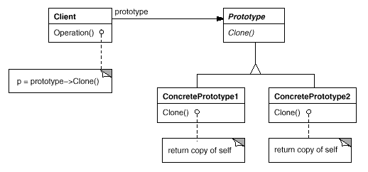
Prototype

Slide 8
Prototype
Participants
  Prototype (Graphic)
    declares an interface for cloning itself.
  ConcretePrototype (Staff, WholeNote, HalfNote)
    implements an operation for cloning itself.
  Client (GraphicTool)
    creates a new object by asking a prototype to clone itself.

Slide 9
Prototype
Consequences
  Adding and removing products at run-time
  Specifying new objects by varying values
  Specifying new objects by varying structure
  Reduced sub classing
  Configuring an application with classes dynamically

Slide 10
Prototype
Related Patterns
  Abstract Factory

